Slide 1
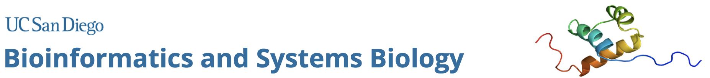
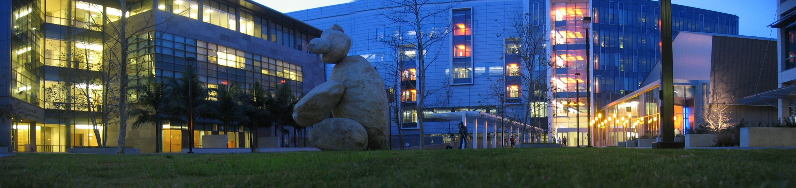
BISB Graduate Program Welcome - 2021
Terry Gaasterland, Program Director
Gene Yeo & Trey Ideker - Program Co-Directors
Lucila Ohno-Machado – BMI Track Director
Fran Perez Estrada – Graduate Program Coordinator
Notes:
1

Slide 2
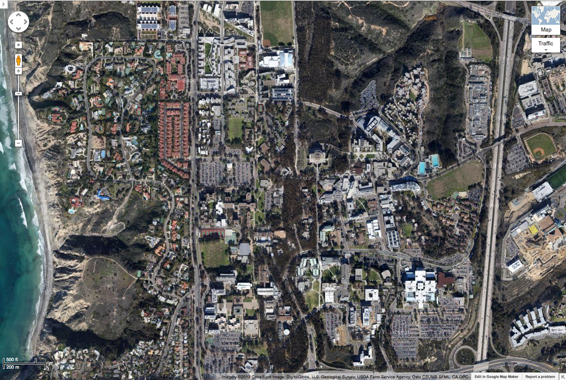
BISB - Diverse, Interdisciplinary Program
Salk
Physical
Sciences,
Biol. Sciences

Slide 3
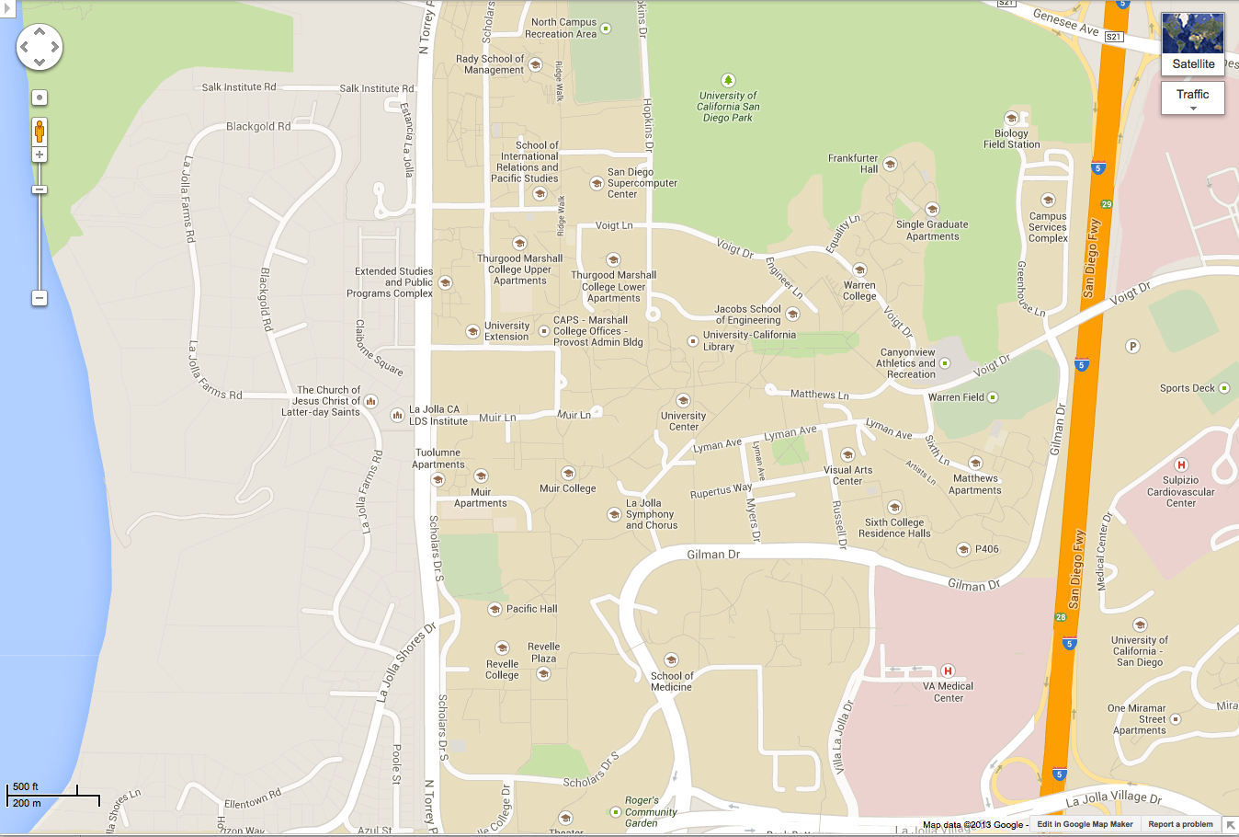
BISB - Diverse, Interdisciplinary Program
Salk
Physical
Sciences,
Biol. Sciences

Slide 4
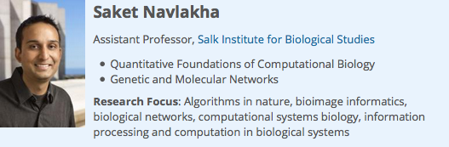
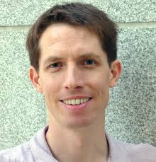
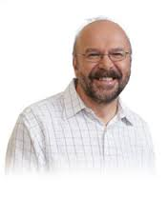
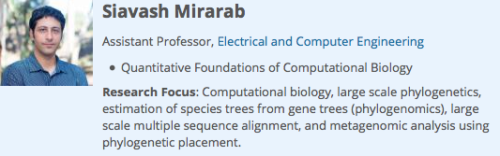
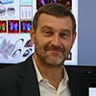
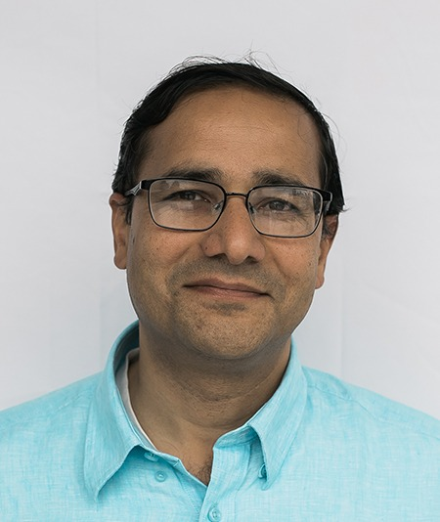
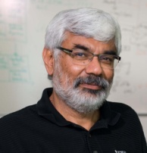
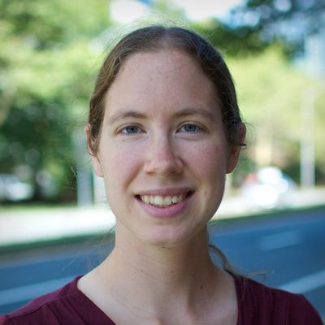
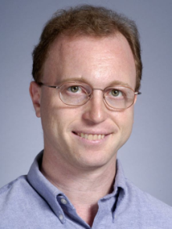
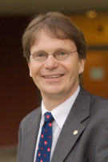
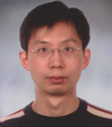
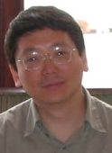
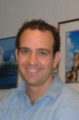
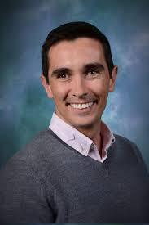
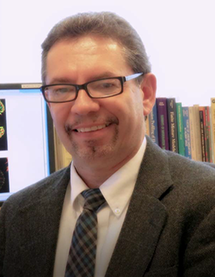
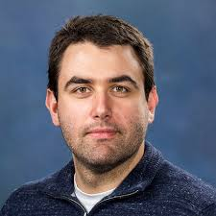
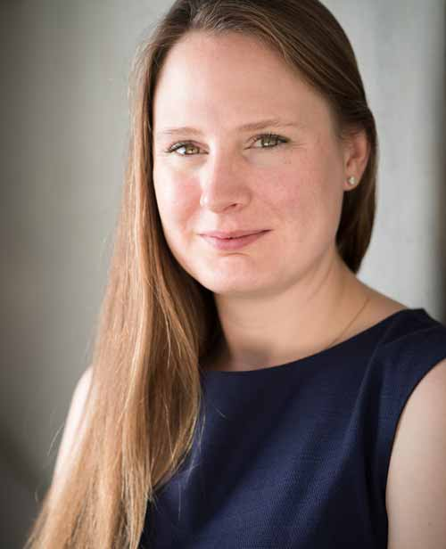
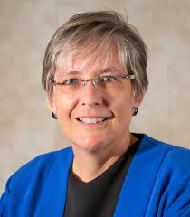
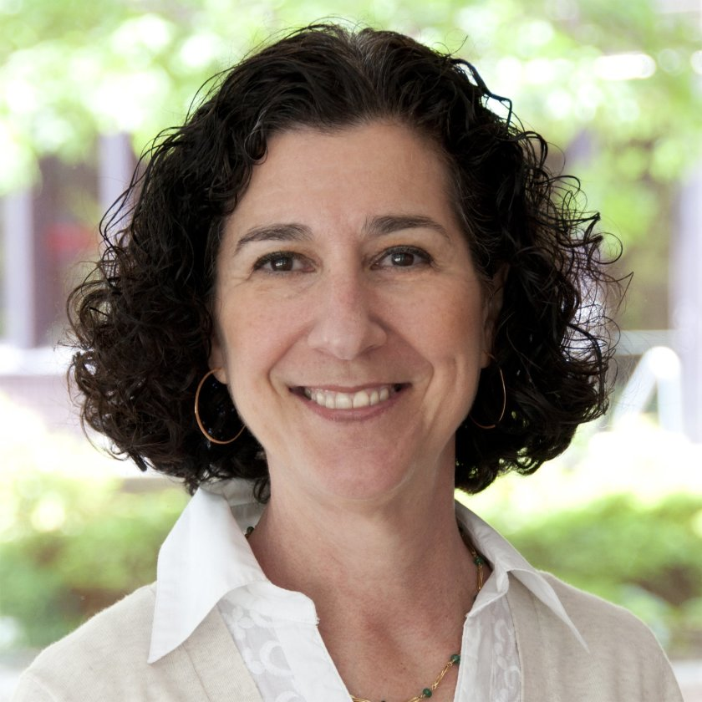
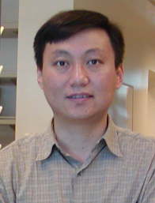
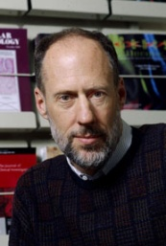
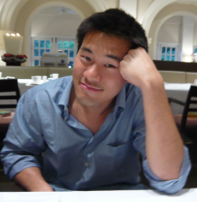
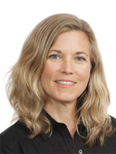
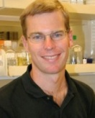
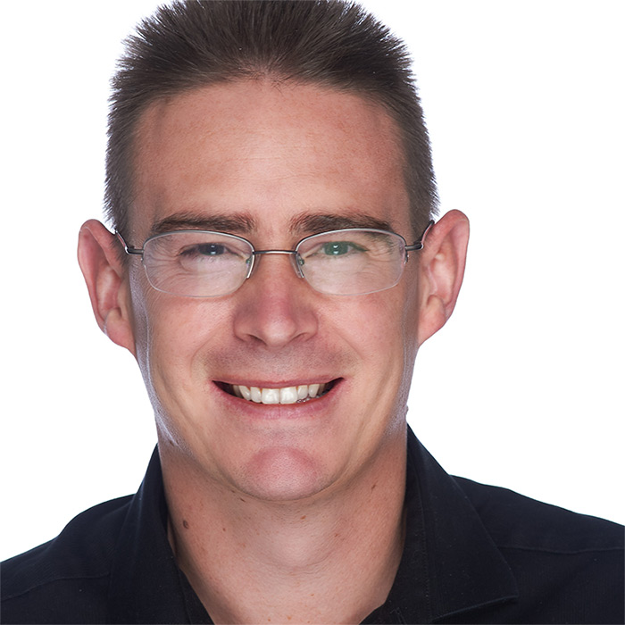
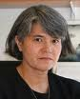
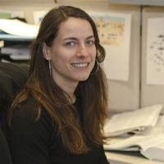
BISB - Diverse, Interdisciplinary Program
Salk
ECE
CSE
Bioeng.
Math
Cancer Center
Biol. Sciences
Medicine, Pharmacy, Biomedical Informatics
Physical Sciences
SIO

Slide 5
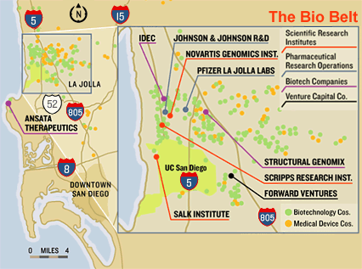


























BISB - Diverse, Interdisciplinary Program

Slide 6
History
2000 Interdisciplinary Bioinformatics PhD program founded
2001 Bioinformatics Training Grant (NIH T32) funded (PI: Shankar Subramaniam). Renewed 2006, 2011
2008 Program renamed “Bioinformatics and Systems Biology” (BISB) 6 Schools: Engineering, Medicine, Biology, Physics, Pharmacy, Scripps Institution of Oceanography
2012 Added Biomedical Informatics (BMI) 2nd Track
100+ students graduated
Directors
2001-2008 Shankar Subramaniam (Bioeng)
2008-2012 Pavel Pevzner (CSE) / Alex Hoffman (Chem)
2012-2013 Alex Hoffman (Chem) / Vineet Bafna (CSE) + Lucila Ohno-Machado (BMI)
2013-2017 Vineet Bafna (CSE) / Bing Ren (CMM)
2017-2019 Vineet Bafna (CSE) / Trey Ideker (Med)
2019- Trey Ideker (Med) / Gene Yeo (CMM )/ Terry Gaasterland (SIO)

Slide 7
Mission
“The ability to harvest the wealth of information contained in biomedical Big Data will advance our understanding of human health and disease; however, lack of appropriate tools, poor data accessibility, and insufficient training, are major impediments to rapid translational impact.”
-NIH BD2K initiative
(Phil Bourne, former
BISB Faculty Member)
Train students in the interdisciplinary fields of Bioinformatics, Computational and Systems Biology.

Slide 8
Training at a glance
 | Year 0 | Year 1 | Year 2 | Year 3 | Year 4 | Year 5
Bootcamp | ✔
Core courses (3+1) |  | ✔ | ✔
Research Rotations |  | ✔
Electives (~4)+Ethics(1) |  | ✔ | ✔
Quals |  |  | ✔
TAship |  |  | ✔ | ✔
Advance to Candidacy |  |  |  | ✔
Colloquium |  | ✔ | ✔ | ✔ | ✔ | ✔
IDP/seminars |  | ✔ | ✔ | ✔ | ✔ | ✔
Defense |  |  |  |  | ✔ | ✔

Slide 9
Training at a glance
 | Year 0 | Year 1 | Year 2 | Year 3 | Year 4 | Year 5
Bootcamp | ✔
Core courses (3+1) |  | ✔ | ✔
Research Rotations |  | ✔
Electives (~4)+Ethics(1) |  | ✔ | ✔
Quals |  |  | ✔
TAship |  |  | ✔ | ✔
Advance to Candidacy |  |  |  | ✔
Colloquium |  | ✔ | ✔ | ✔ | ✔ | ✔
IDP/seminars |  | ✔ | ✔ | ✔ | ✔ | ✔
Defense |  |  |  |  | ✔ | ✔

Slide 10
1st Year Rotations
Each Quarter Year 1
Goal 1: Learn how to define a problem, lay out a plan of attack, generate results, evaluate next steps
Goal 2: Connect with 1 to 3 labs, find a PI/Advisor, gravitate toward a lab to join by summer
Each Quarter: Rotation Proposal + Rotation Report

Slide 11
Rotation Projects
The goal of a rotation is to select an academic advisor. Take it seriously.
Questions:
Is the PI looking for an advisee? Will they support you financially if it works out?
Do the projects excite you? Do they match with your career goals? Remember, rotation project may not be your thesis project.
Read some of the PI’s publications. Can you see yourself doing similar work?
Talk to some of the lab members. Does the PI’s working style match your own?

Slide 12
2nd Year Qual Exams
Spring Quarter Year 2
Goal: Evaluate, are you are ready for independent research?
You will propose a research project, show preliminary data with significant progress, answer questions and lead discussion about your problem area
Challenges
Open questions
What have others done? What is missing so far?

Slide 13
Faculty Committees
Steering Committee (Gaasterland)
Curriculum Committee (Tesler)
Outreach and Student Affairs (Tesler)
Admissions and Recruitment (Carter, Tesler)
Diversity (Bafna)
Training Grant (Subramanium/ Gaasterland/Bafna)
Fellowship Training (Carter)
Fellowship Selection (Mali)

Slide 14
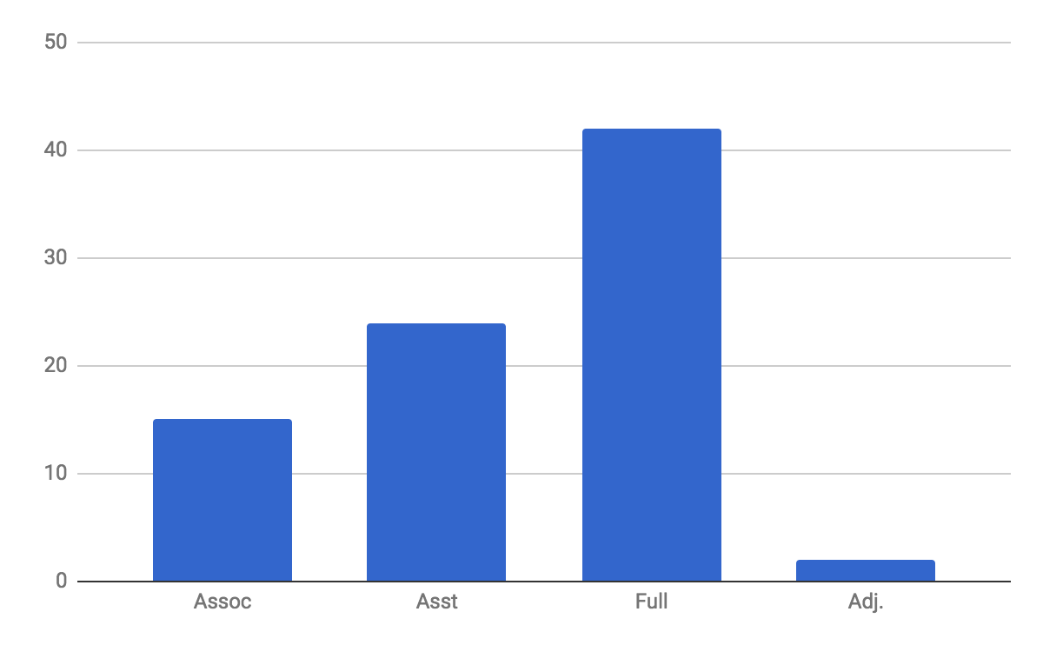
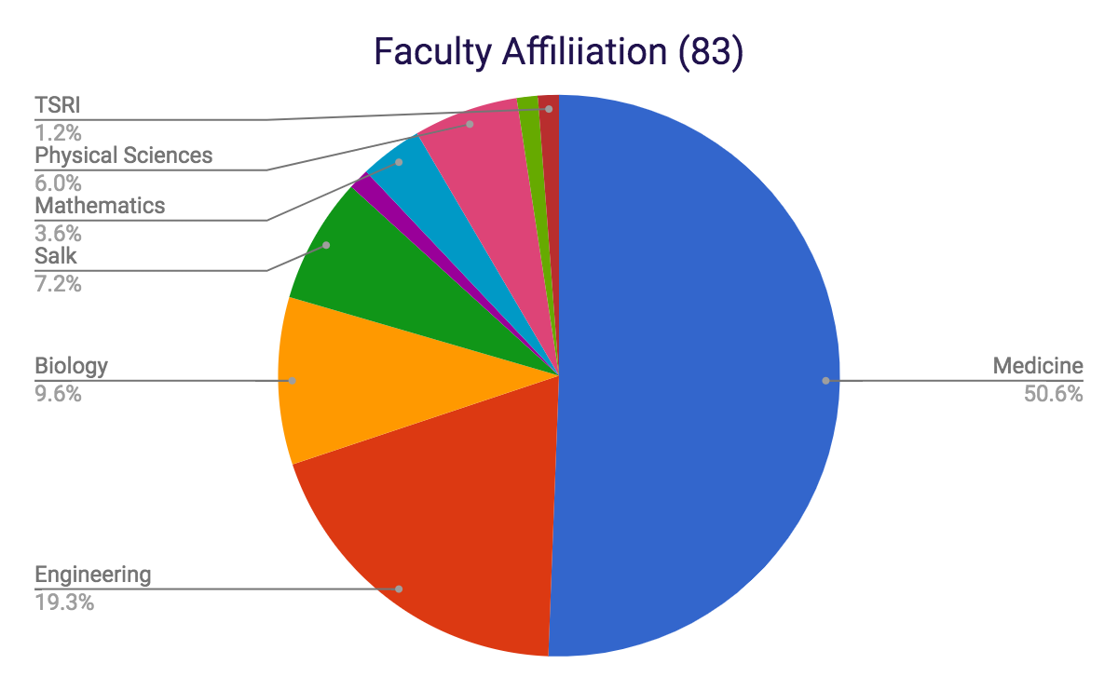
BISB Faculty Affiliation – by School (83)
SIO (Scripps) (1.2%)
Physical Sciences (6%)
Mathematics (3.6%)
Salk (7.2%)
Biology (9.6%)
Medicine (50.6%)
Biological Sciences (19.3%)

Slide 15
Faculty Engagement
Admissions
Research rotations
Teach core and elective classes
Serve on qualifying exam committees
Thesis advising and senate exam committees
Thesis committees
Participate in visit day, colloquium series, student seminars and journal clubs

Slide 16
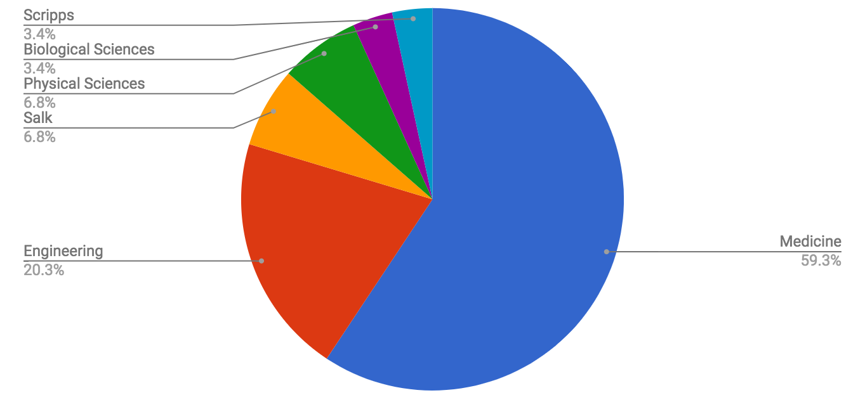
BISB Students – Lab Home Schools

Slide 17
Funding (typical one year snapshot)
 |  | Budget
Admin Budget | SVCAA | $15,000
 | Biol Sciences | $14,250
 | JSOE | $14,250
 | Physical Sciences | $14,250
 | Medicine | $19,250
 | Expenses | -$77,000
 | Net | 0
Student Budget | Training Grant | $845,000 | includes “overhead”
 | Block Grants | $214,996
 | Salk | $49,000
 | GSGEI | $224,128

Slide 18
Key people
Graduate Coordinator: Fran Perez Estrada
Finances & Operations: Elizabeth Soos
Steering Committee: 15+ faculty
Admissions Chairs: Glenn Tesler Hannah Carter
Admissions Committee: 30+ faculty
BISB Students

Slide 19
Alumni in ACADEMIA - examples
Name | Position | Institution/Company
Markus Covert | Professor | Stanford University
Sourav Bandyopadhyay | Asst. Professor | UC San Francisco
Nathan Price | Professor | Institute for Systems Biology
Jason Papin | Asoc. Professor | University of Virginia
Shaojie Zhang | Assoc. Professor | Univ. Central Florida
Samuel Payne | Senior Scientist | Pacific Northwest Natl Laboratory
Ines Thiele | Asst. Professor | University of Iceland
Degui Zhi | Asst. Professor | University of Alabama
Ali Bashir | Asst. Professor | Mount Sinai Medical School
Noah Zaitlen | Asst. Professor | UC San Francisco
Gary Hon | Asst. Professor | UT Southwestern
Albert Hsiao | Asst. Professor | UC San Diego
Juan Rodriguez | Instructor | Weill Cornell Medical College

Slide 20
Alumni in INDUSTRY - examples
Name | Position | Institution/Company
Nitin Udpa | Bioinformatics Scientist | Illumina
Stephen Tanner | Senior Director | Illumina
Sam Payne | Senior Scientist | Pacific NW labs
Ryan Kelly | Senior Scientist | Illumina
Derren Barken | Bioinformatics Scientist | Prometheus
Han-Yu Chuang | Bioinformatics Scientist | Illumina
Jan Schellenberger | Scientist | ID Analytics
Jocelyne Bruand | Scientist | Illumina
Markus Kinsella | Scientist | Pacific Biosciences
Sid Selvaraj | Founder, CEO | Arima Genomics, Inc.
Vipul Bhargava | Senior Scientist | Janssen Labs (J&J)
Roy Ronen | VP | Data4Cure
Matt Schulz | Scientist | Human Longevity Inc
Boyko Kakradov | Scientist | Human Longevity Inc

Slide 21
BISB Graduate Program Welcome - 2021
Terry Gaasterland, Program Director
Gene Yeo & Trey Ideker - Program Co-Directors
Lucila Ohno-Machado – BMI Track Director
Fran Perez Estrada – Graduate Program Coordinator
Notes:
21

